Slide 1

Cloud Workshop
Cloud Technology Essentials

Slide 2


Outline
Networking
1
2
Cloud
Deployment
3
4
Breakout
More on Cloud
5
6
Q & A

Slide 3
?
What did just happened?

Slide 4




Networking
Essential Basics
How information is transmitted over computer networks, network architecture, HTTP, APIs, and web applications
Notes:
Please, replace the image with a more suitable. Avoid removing the blue shape!

Slide 5

Networking Objectives
🥚 Basic
🥚 Layers of Networking
🥚 Data exchange in the Internet
🥚 Web applications
✔️ Advanced
✔️ Requests and responses ✔️ API
✔️ Flask

Slide 6
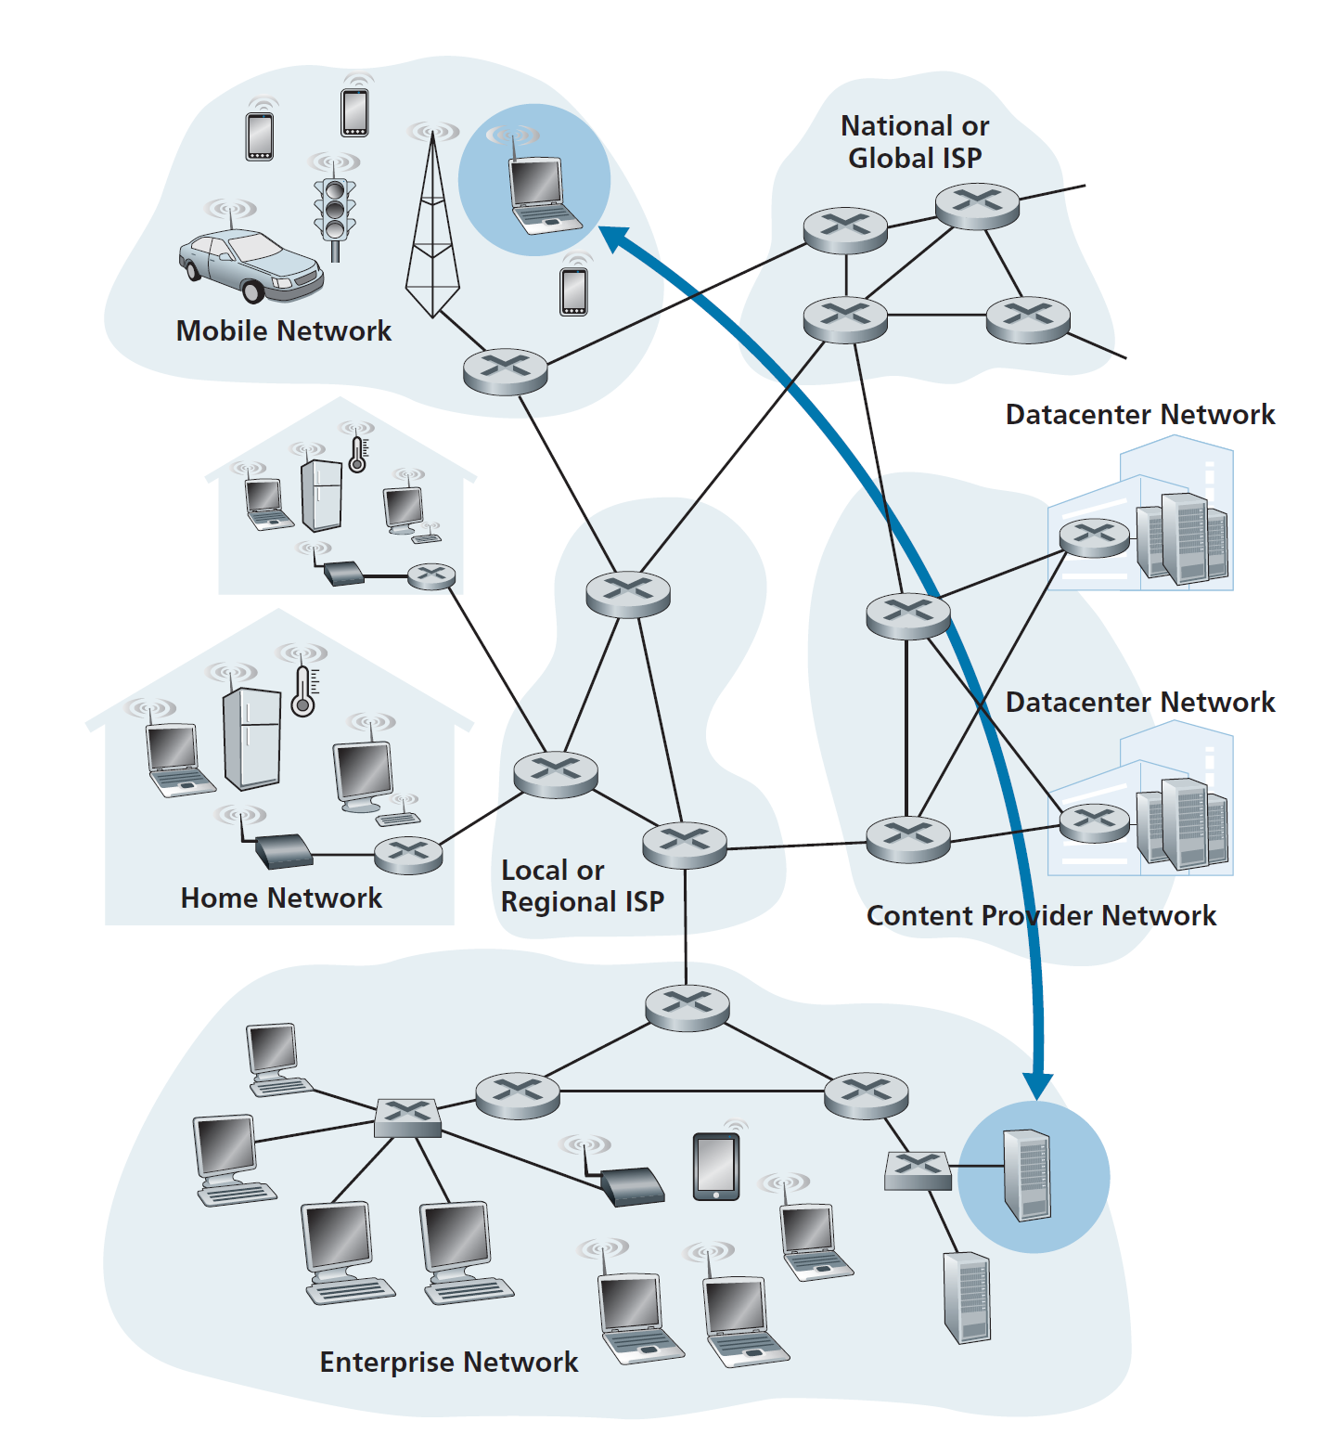

Slide 7
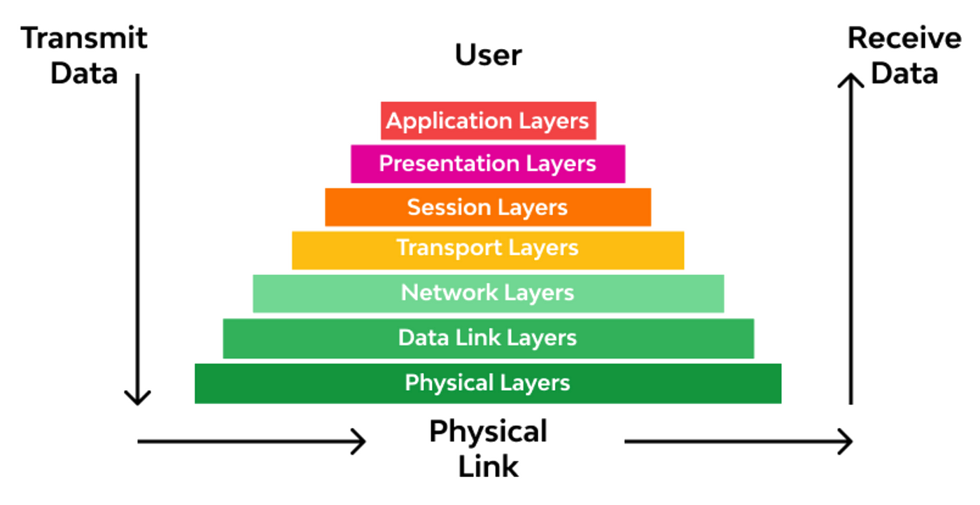
Layers of Networking

Slide 8
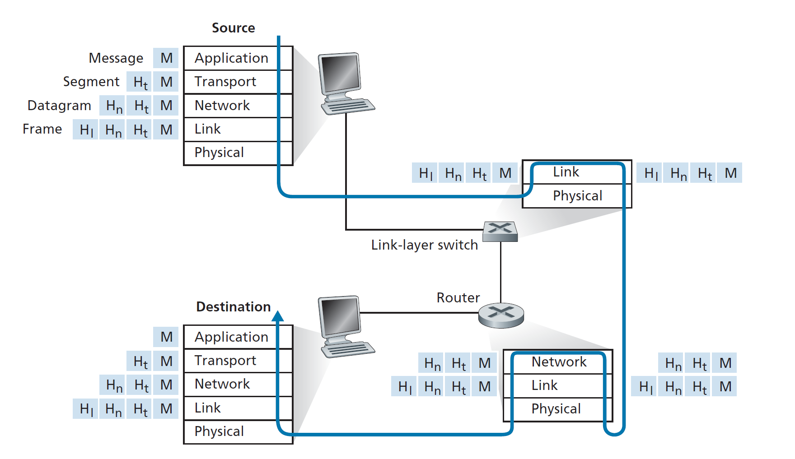

Slide 9
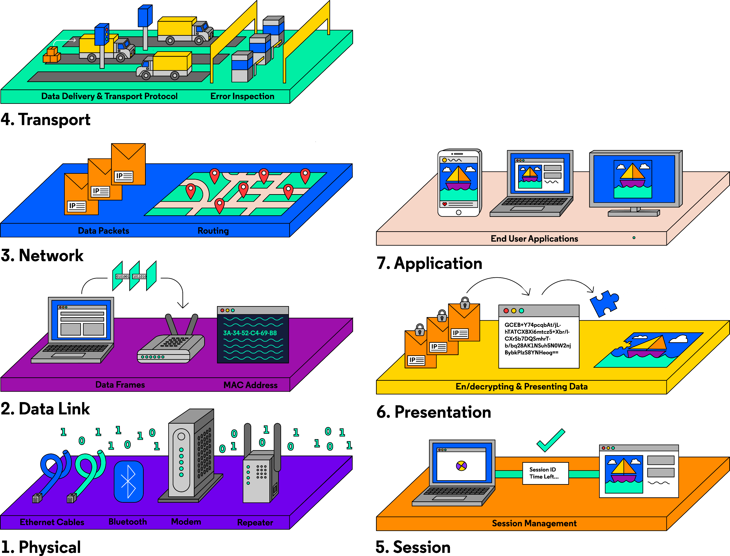

Slide 10
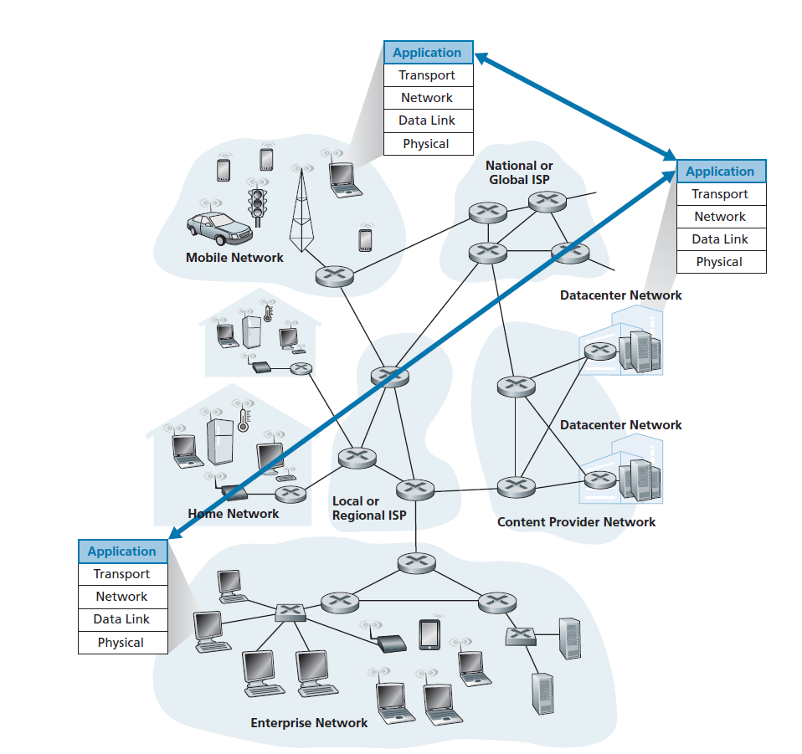

Network Architecture
End-system interaction

Slide 11
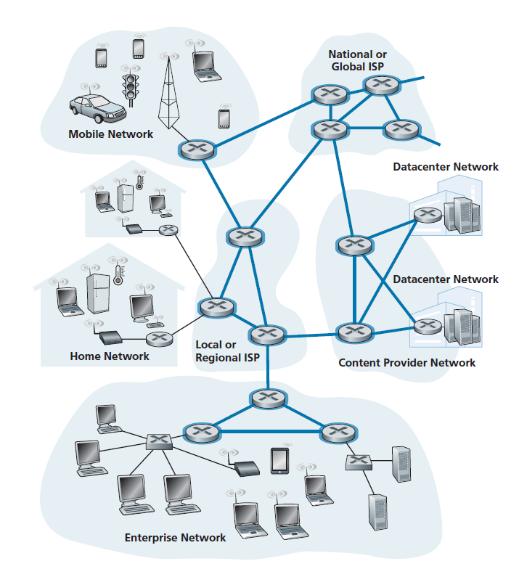
Network core

Slide 12
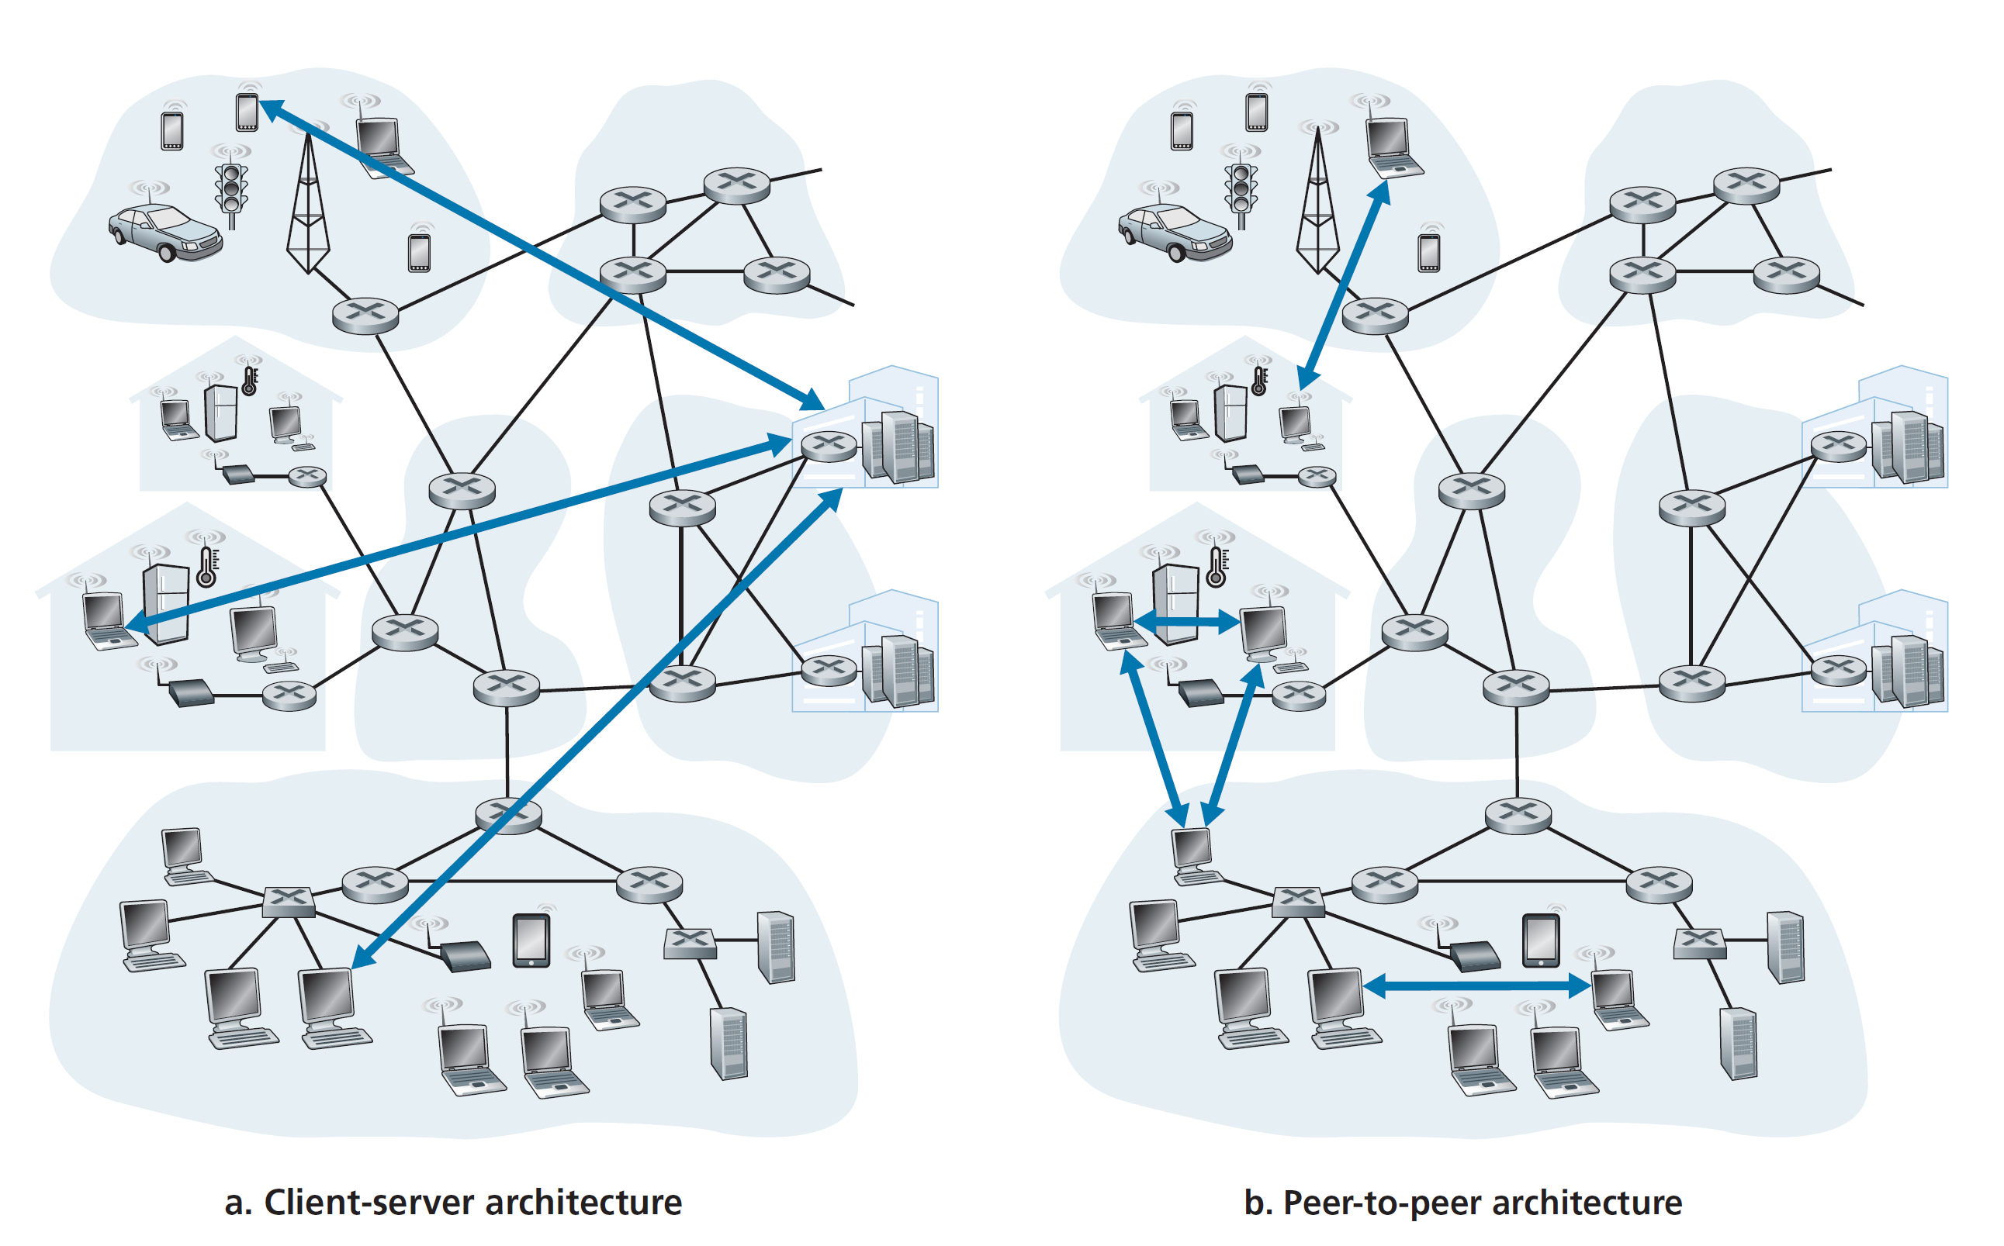

Slide 13

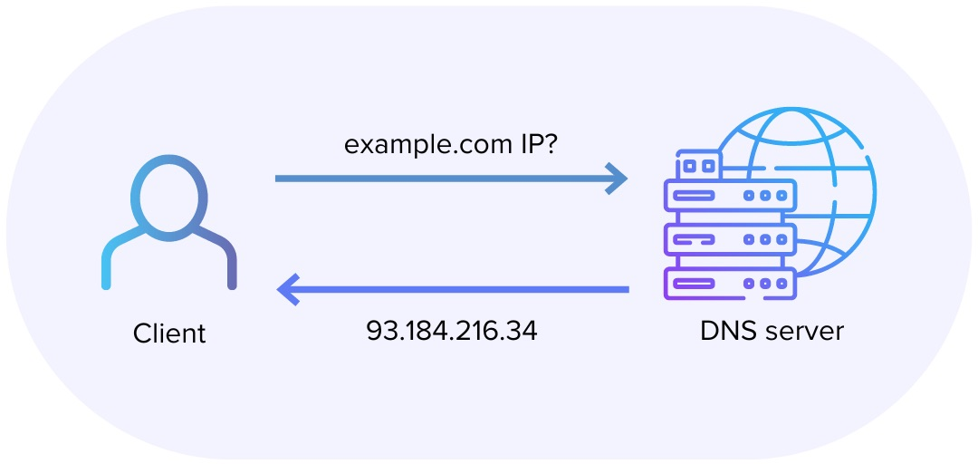
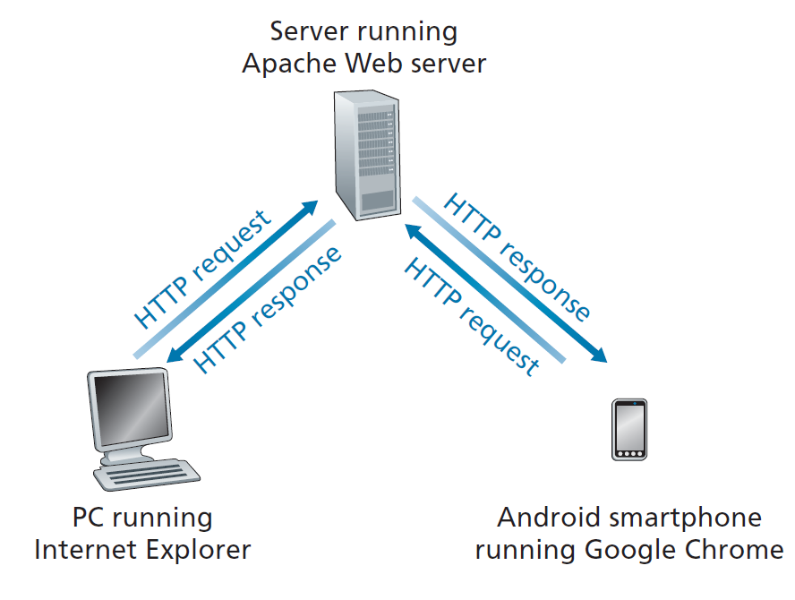
Request - Response
HTTP Methods:
GET, POST, PUT, DELETE

Slide 14
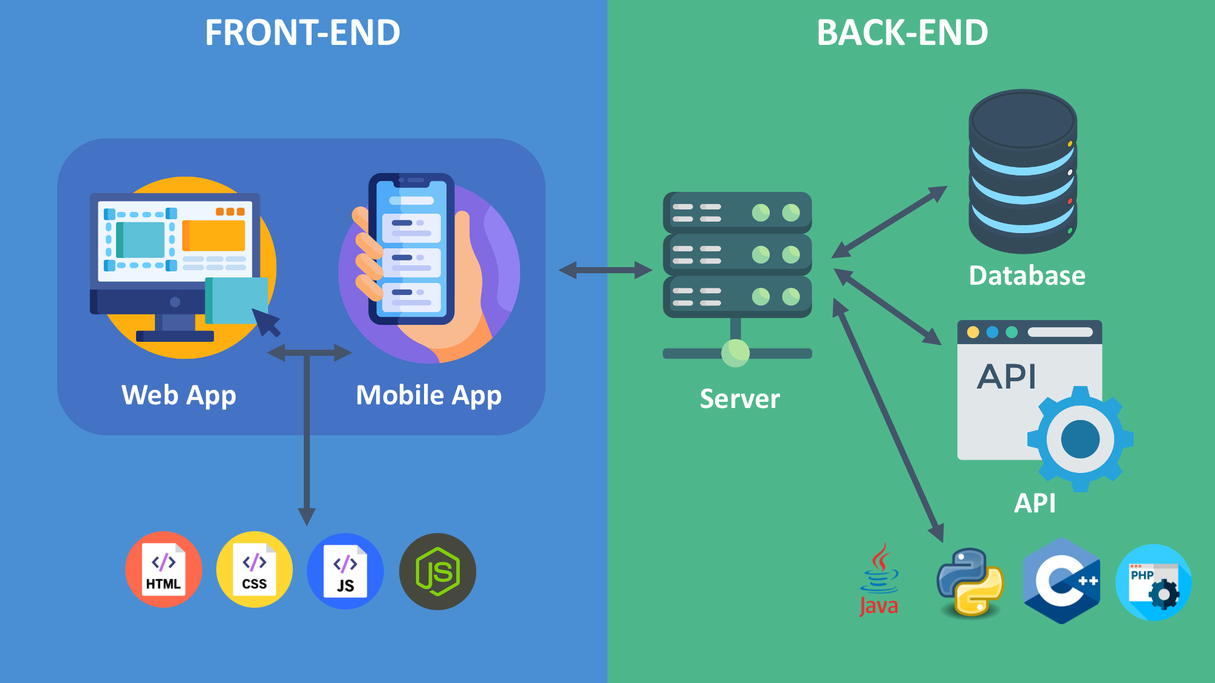

Slide 15
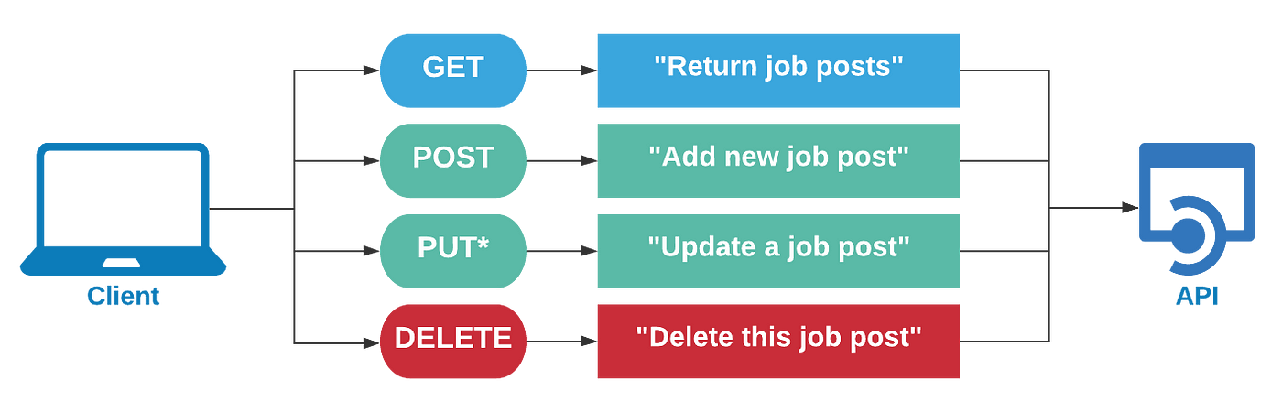
Application Program Interface

Slide 16
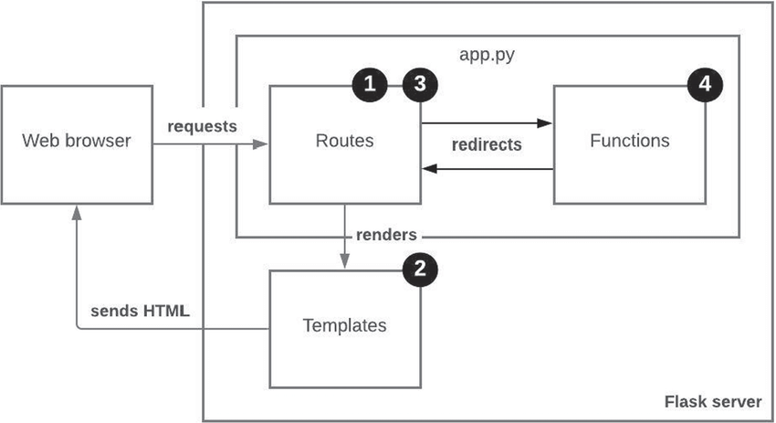
Flask
Flask - Python framework for web application

Slide 17

“
If you are a data scientist do you need to know about networking?
Discussion

Slide 18


Cloud
Cloud Technology
Cloud Infrastructure, Platform, and Software as a Service
Notes:
Please, replace the image with a more suitable. Avoid removing the white shape!

Slide 19
Cloud Objectives
🥚 Basic
🥚 What is Cloud?
🥚 How do we use Cloud?
🥚 Do we need Cloud?
✔️ Advanced
✔️ IaaS, PaaS, SaaS ✔️ Different ways of Deployment
✔️ Pros and Cons

Slide 20
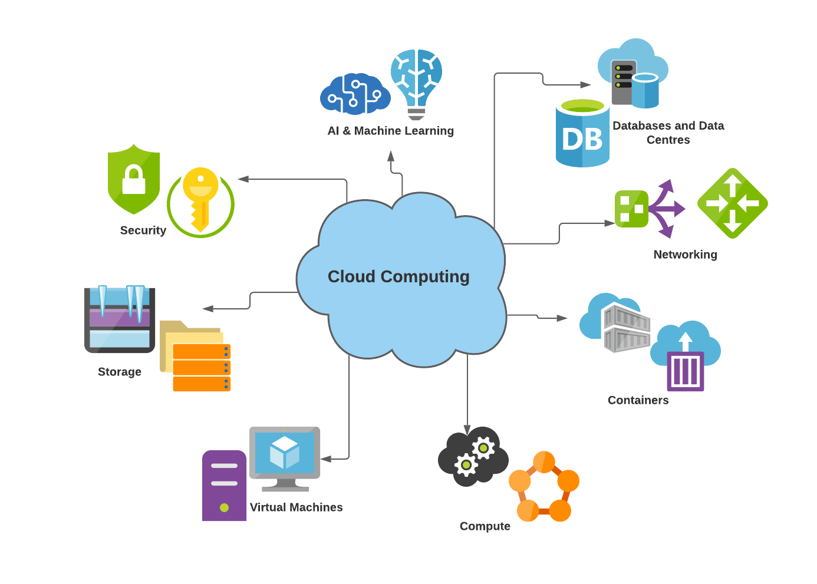

Slide 21
“
What cloud services have you used today?
Discussion

Slide 22
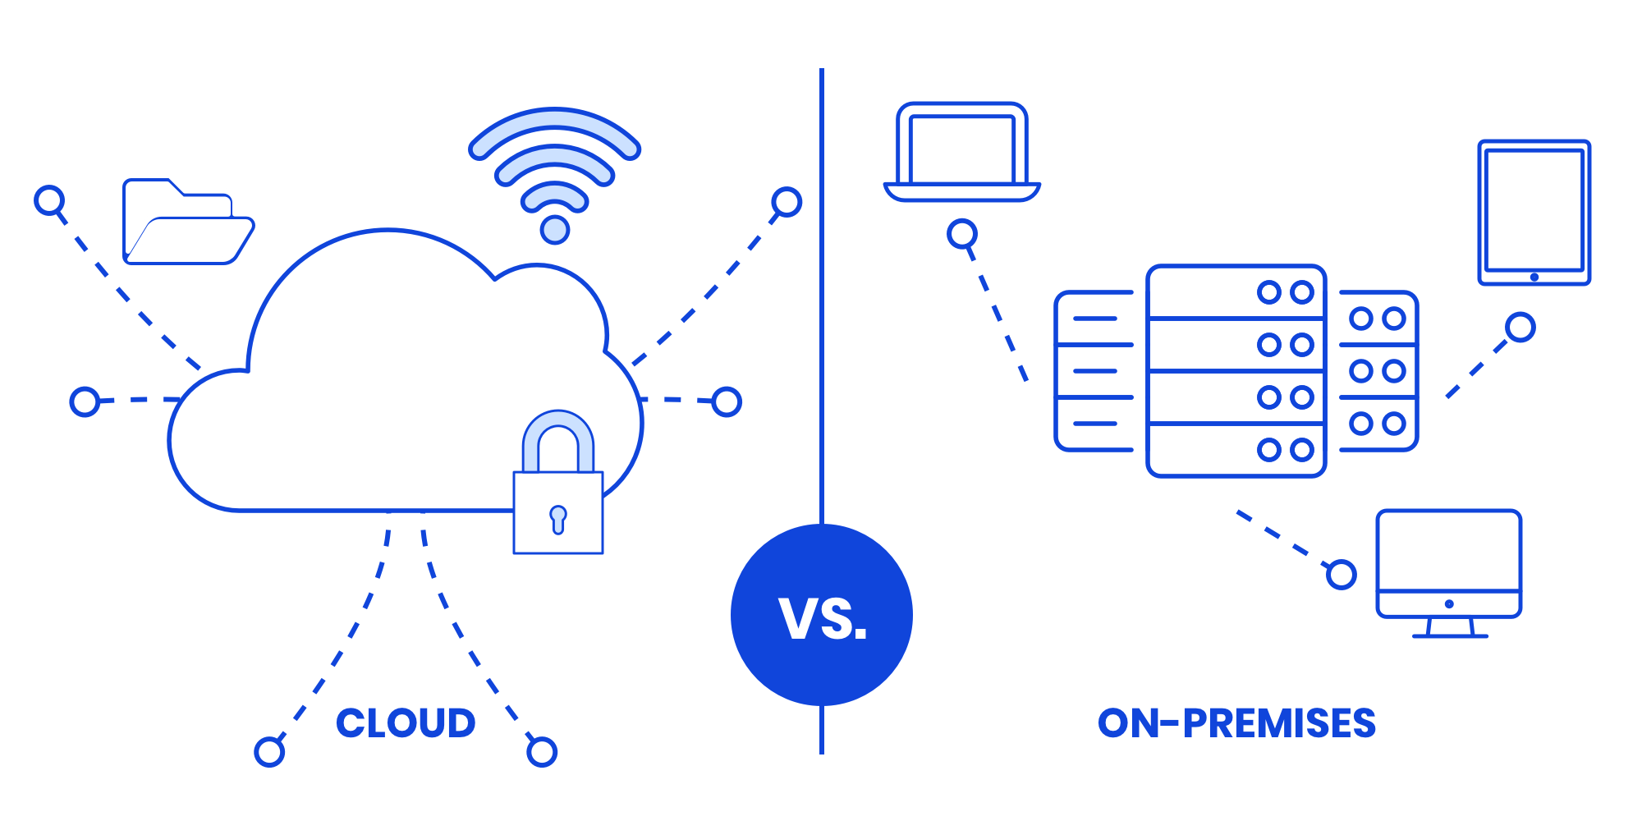
Cloud vs on-premise

Slide 23
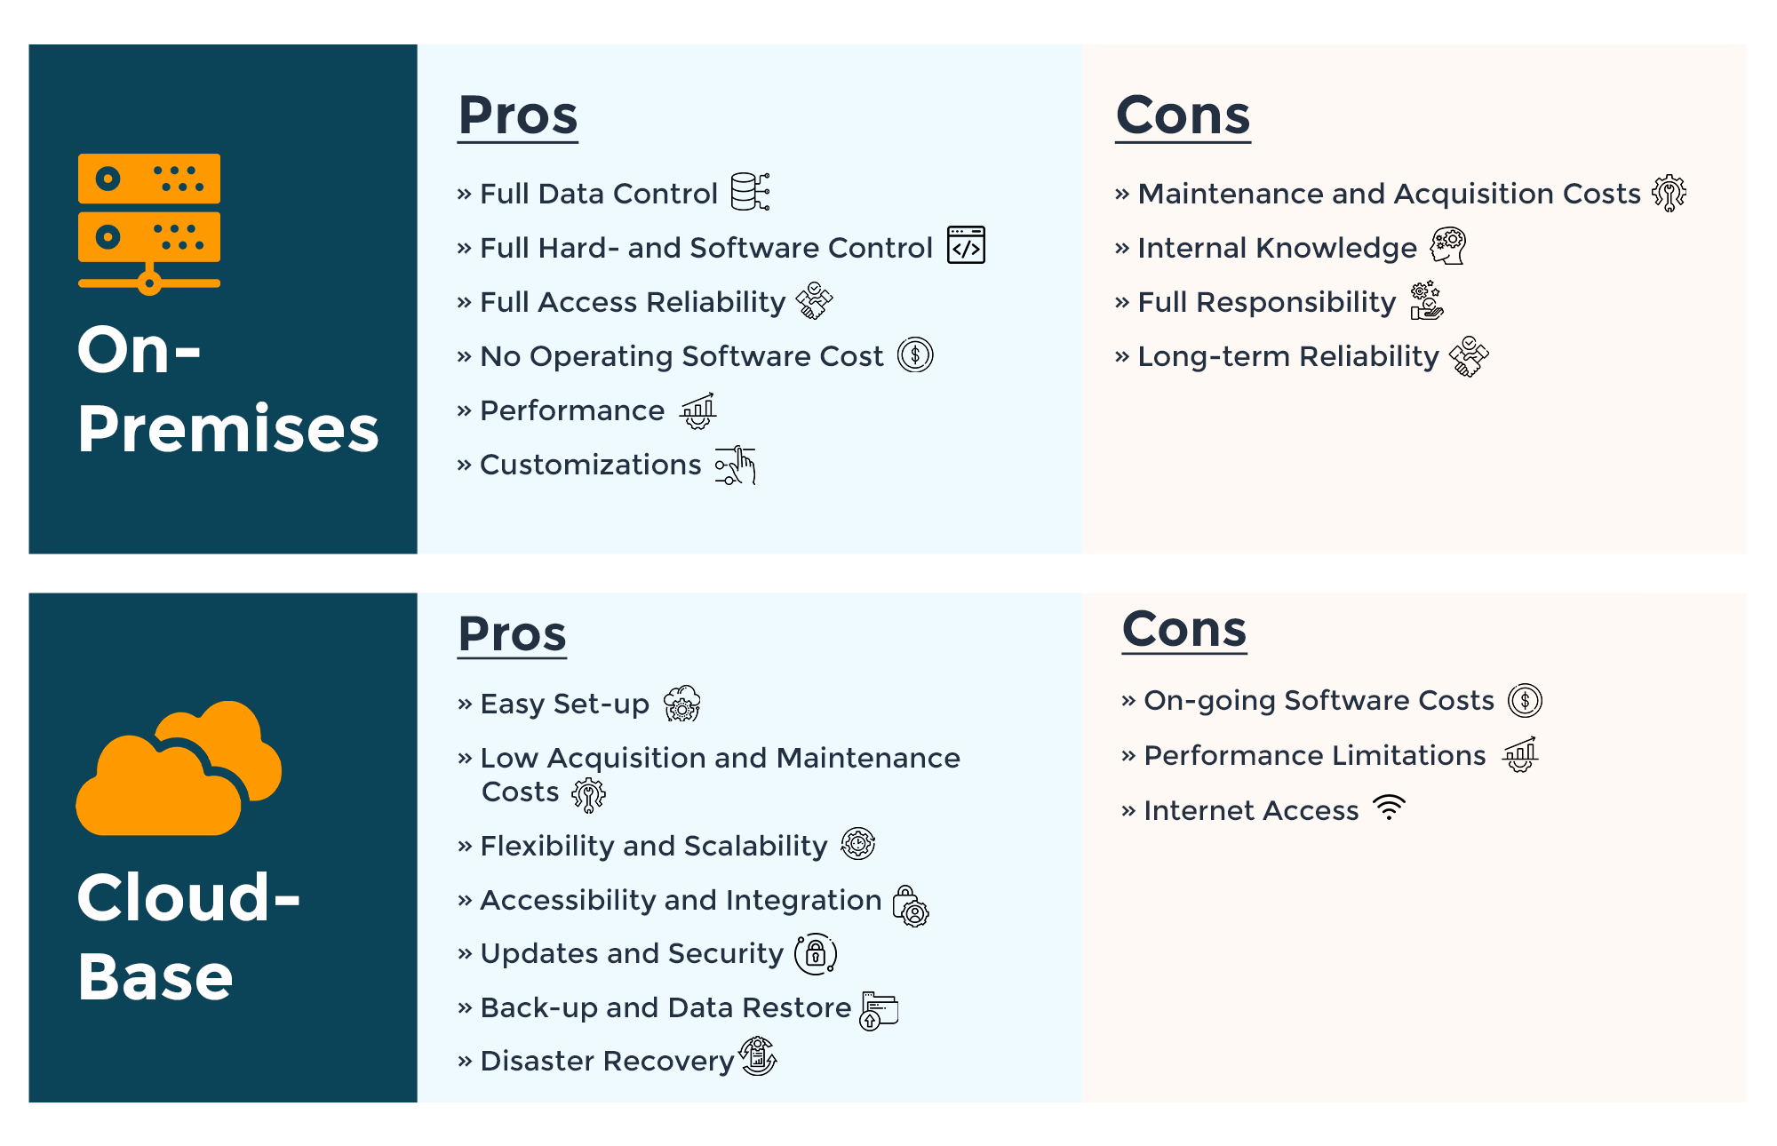

Slide 24
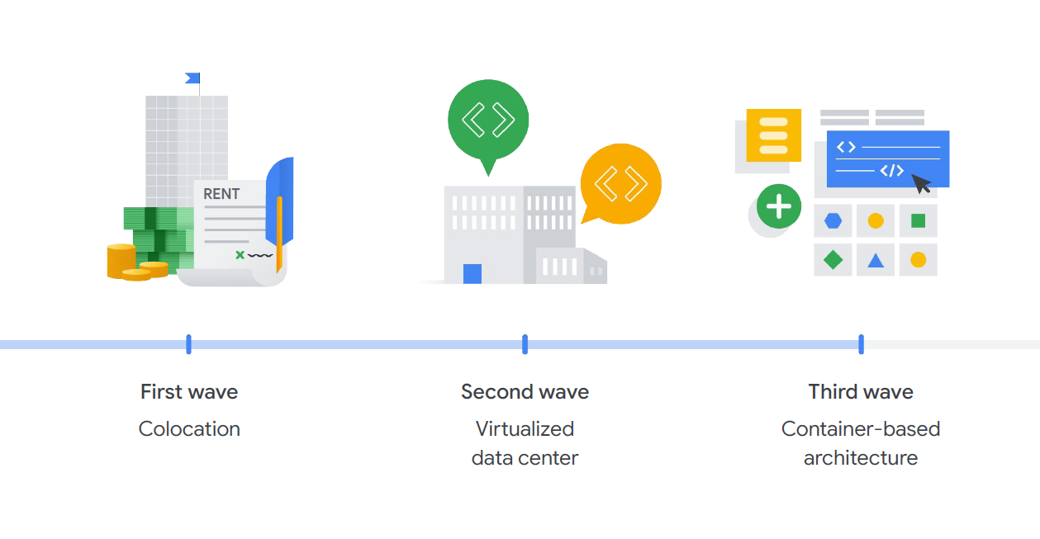
Evolution of Cloud

Slide 26



Cloud Providers
and many more

Slide 27
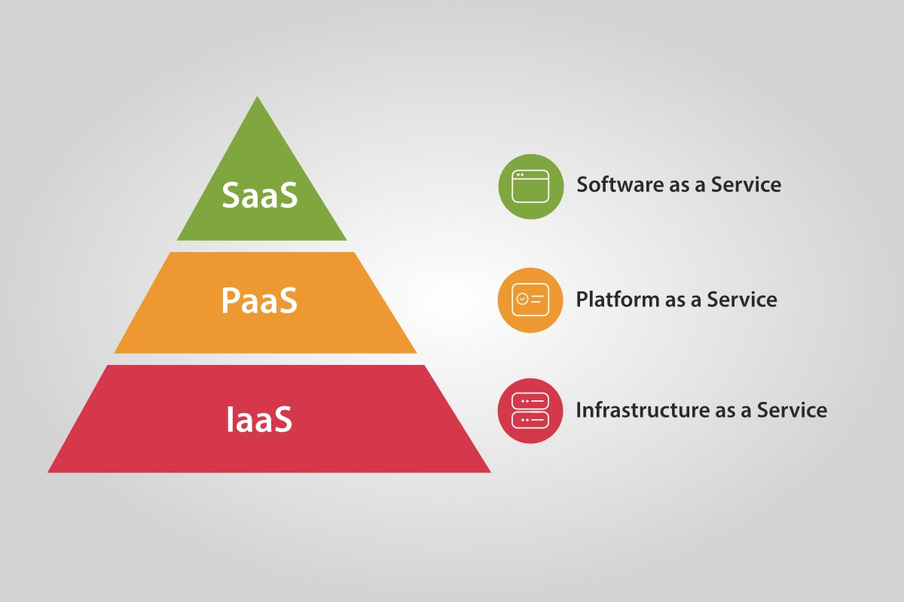
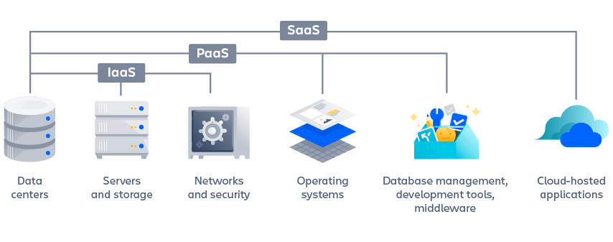
Cloud offerings

Slide 28
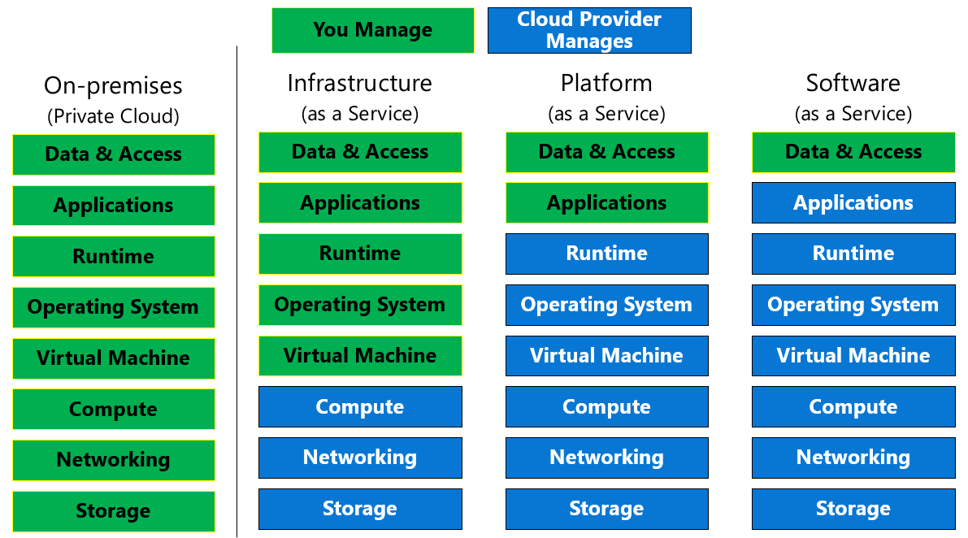

Slide 29
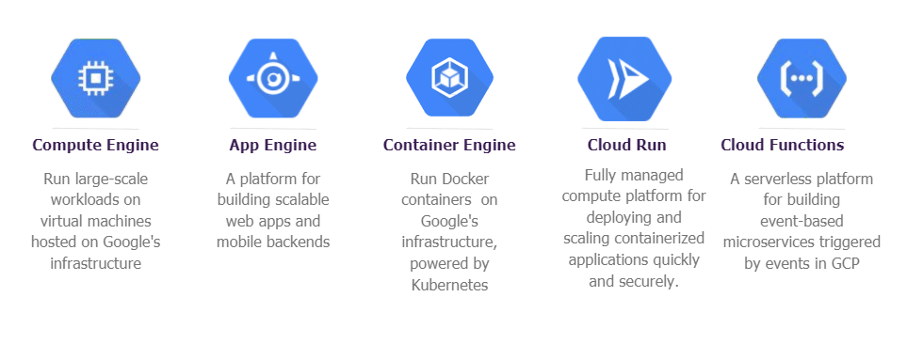
Deploying to Google Cloud
Compute Engine
App Engine
Kubernetes
Cloud Run
Cloud Functions

Slide 30
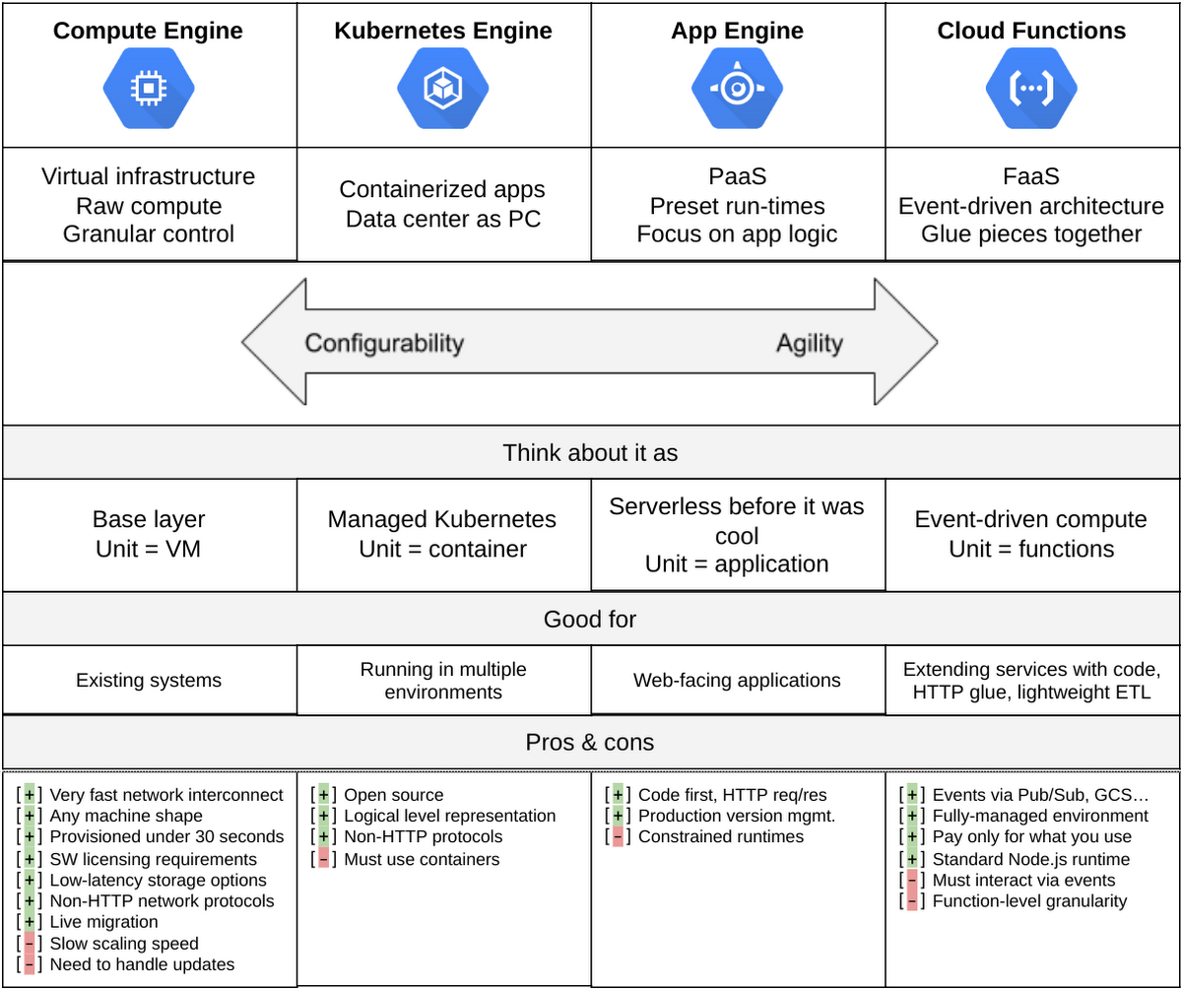

Slide 31
“
Do we need cloud services for our applications?
Discussion

Slide 32



Google Cloud App Engine deployment
Notes:
Replace image with a new one

Slide 33


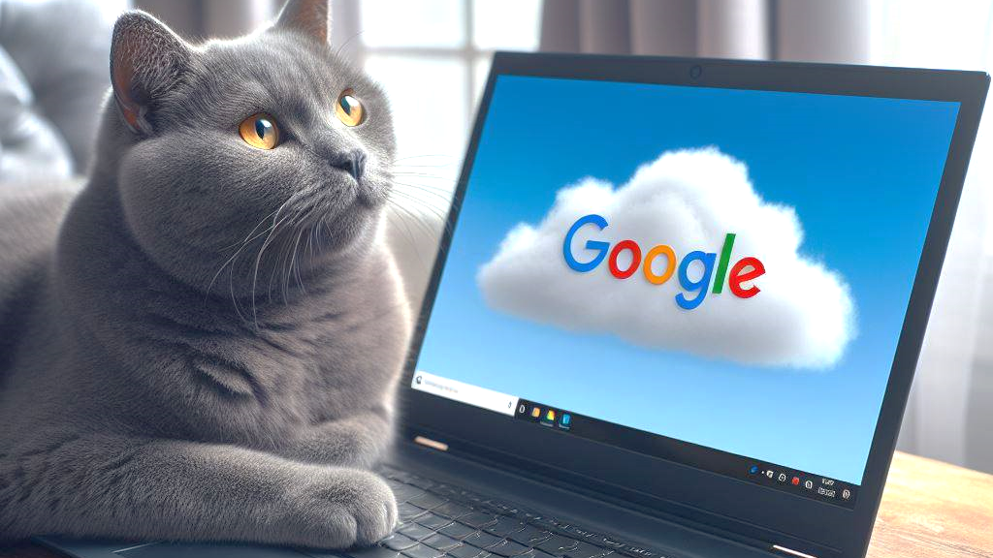
Breakout activity

Slide 34
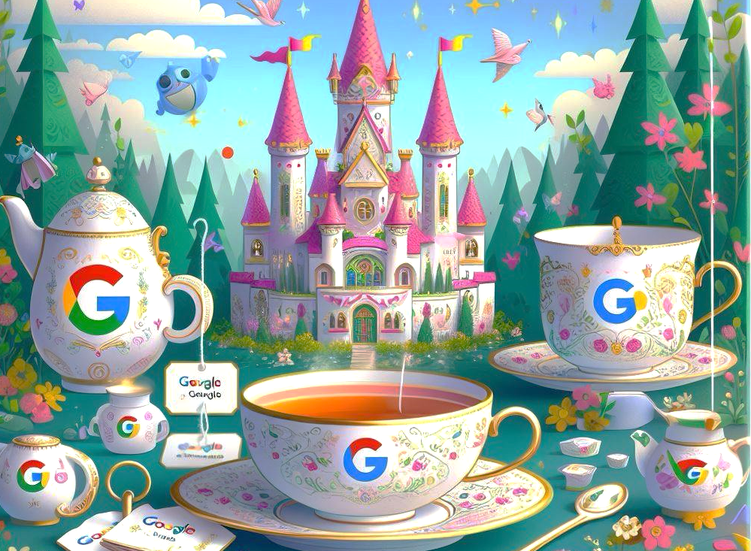
Breakout discussion
Notes:
Replace image with a new one

Slide 35

Advanced topics
More on Cloud
Cloud services and costs in cloud Further topics
Notes:
Please, replace the image with a more suitable. Avoid removing the blue shape!

Slide 36
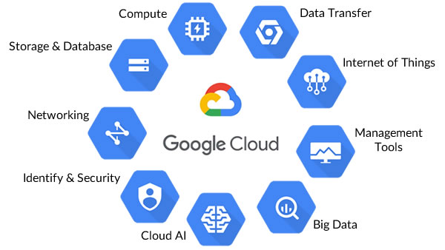
Google Cloud offerings
Google Cloud Developer Cheat Sheet

Slide 37
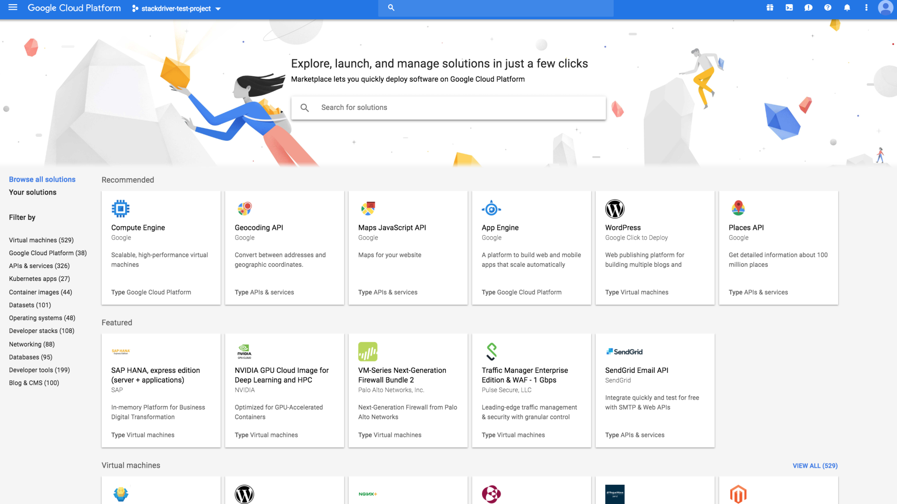

Slide 38
Costs in Cloud
Most of services are paid
Free trial period 3 month with GCP
Free tier amount for many services
Control usage Use budget limits
After trial period see what free tier offers, control usage and set budger limits

Slide 39
Further topics
Storage, SQL
Big Data
Containers
Continuous Integration / Continuous Deployment
Scaling Load Balancing
ML and AI in Cloud

Slide 40
Example of web application in GCP

Slide 41
Q & A

Slide 42

Thank You!

